Slide 1

Dot Net Core Web API
By Logaraja Esakki

Slide 2
Agenda
1
REST API - Intro
2
Understand Basic OOPS
3
.Net Core API – Basic
4
.Net Core API – Advanced
5
Clarifications

Slide 3
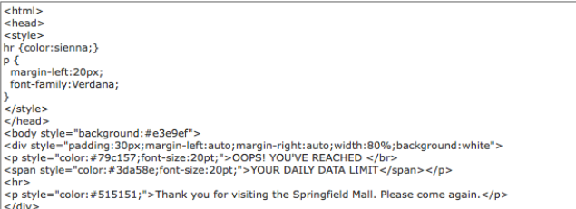
Traditional APP
Web
Get Employees page
Server App
Returns Html Data
Mobile?

Slide 4
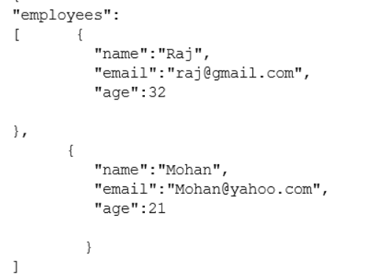
Rest API - Basics
Client
Get Request(Employees)
API
Returns Json Data
Dot Net
ReactJs
Angular
React Native
Etc
.net , .net core
nodejs
php
Phython(flask)
Etc

Slide 5
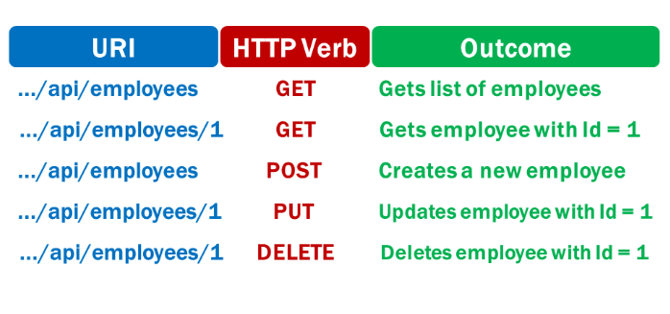
Rest API – Http Verbs

Slide 6
Basic C# Excercise
EmployeeDb
Employees | List<Employee>
+ AddEmployee(Employee emp)
+ AddEmployee(Employees emps)
+ DeActivateEmployee(int empId)
+ ActivateEmployee(int empId)
+ GetOverAllSalary()
+ GetEmployee(int empId)
+ GetEmployees()
Employee
EmployeeId | int
EmployeeName | string
Dob | DateTime
DoJ | DateTime
CityName | string
StateName | string
Salary | Decimal
IsActive | bool
IsDeleted | bool

Slide 7
Sample Api Creation

Slide 8
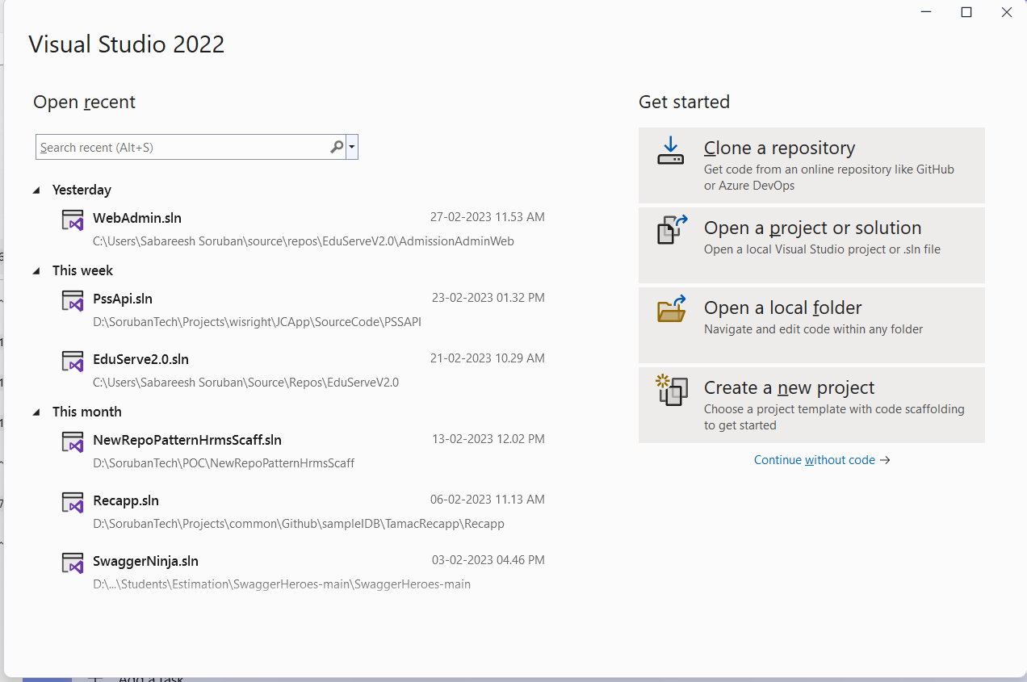

Slide 9
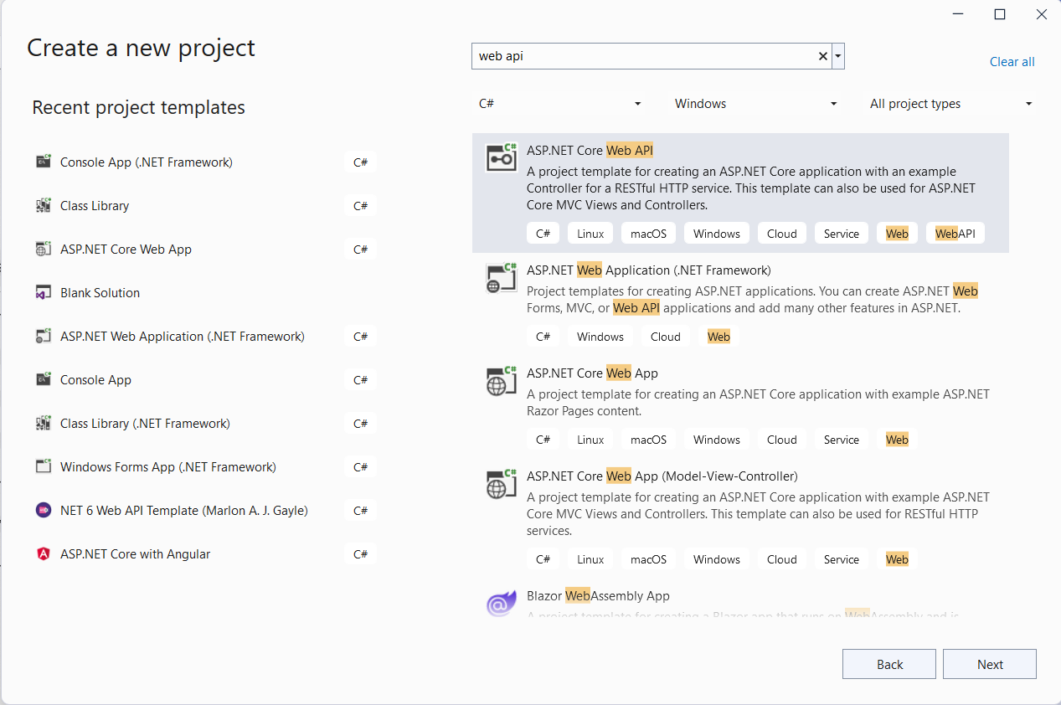

Slide 10
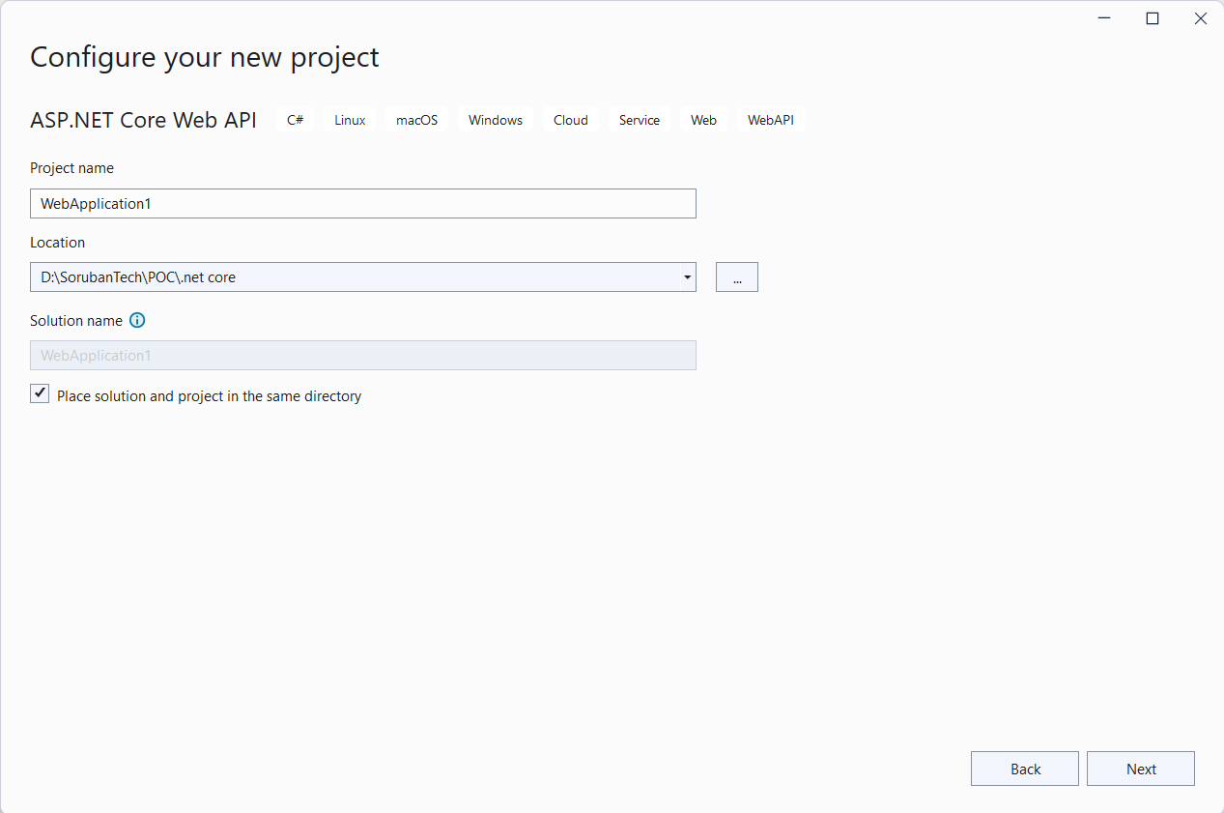
Name of your project

Slide 11
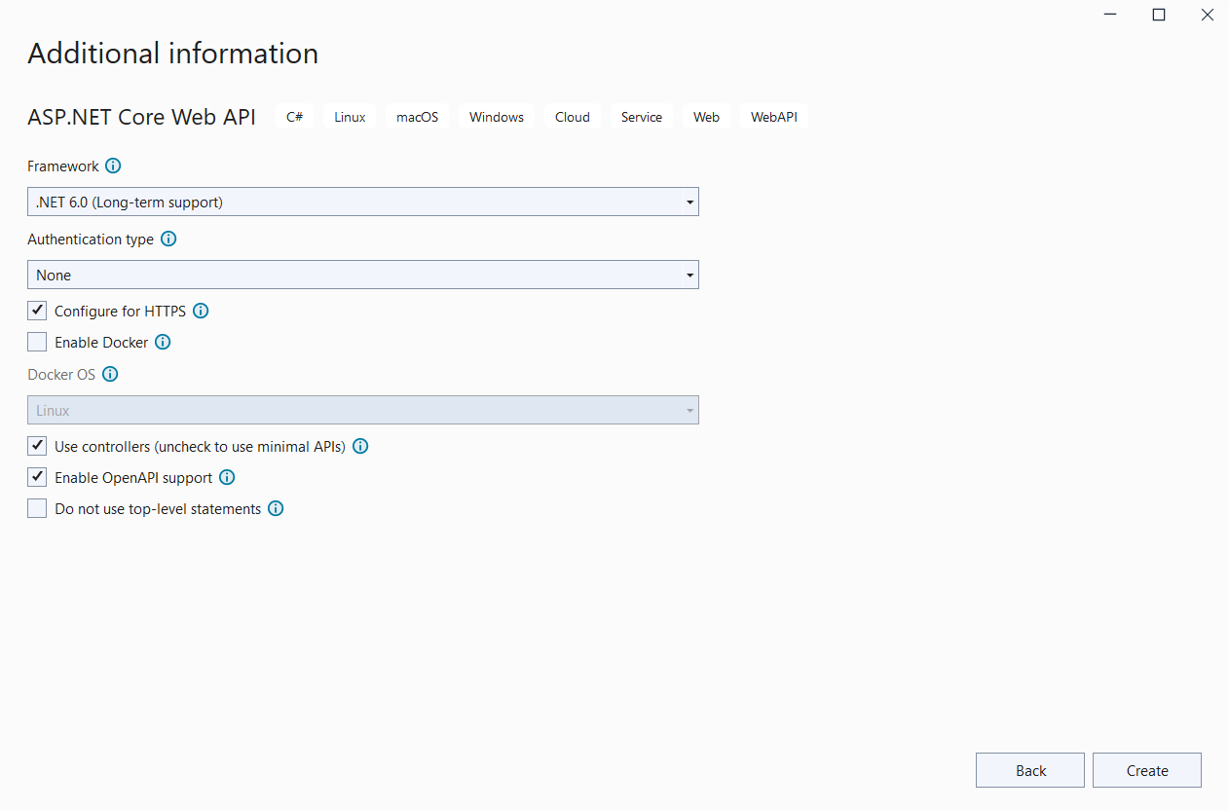
Uncheck if you are in college

Slide 12
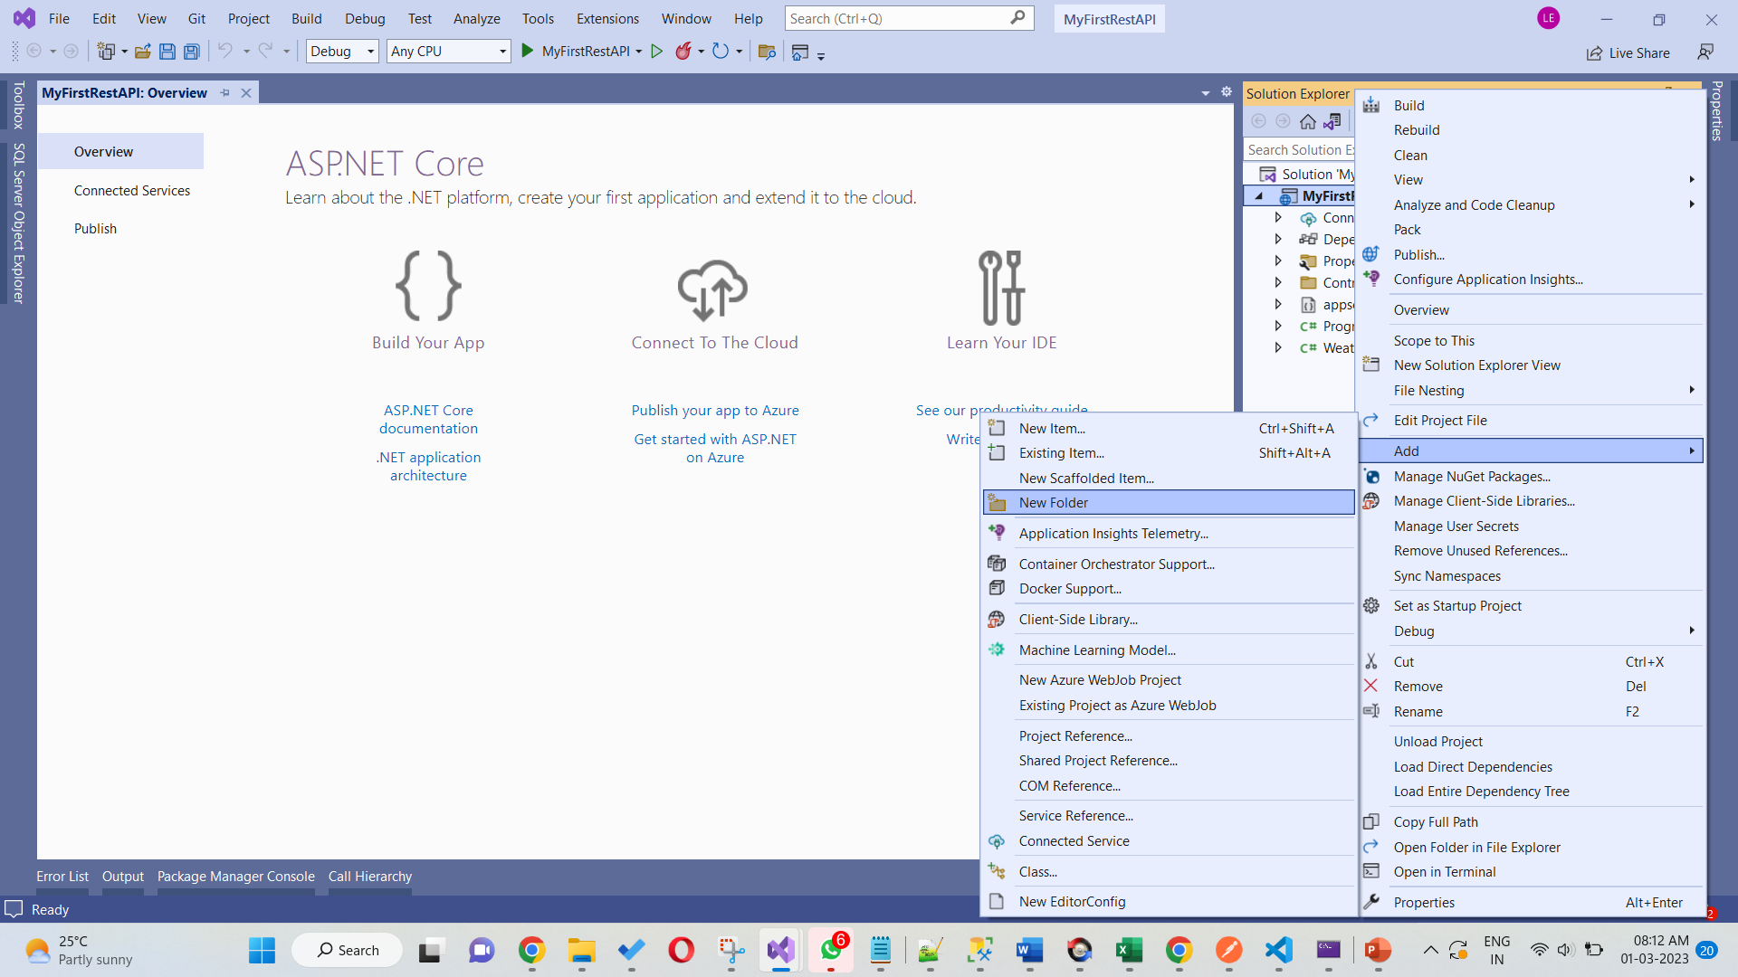
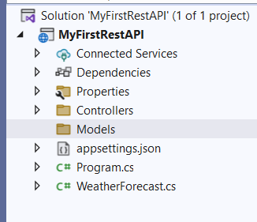
Create Folder of your models. Models are nothing but your db structure

Slide 13
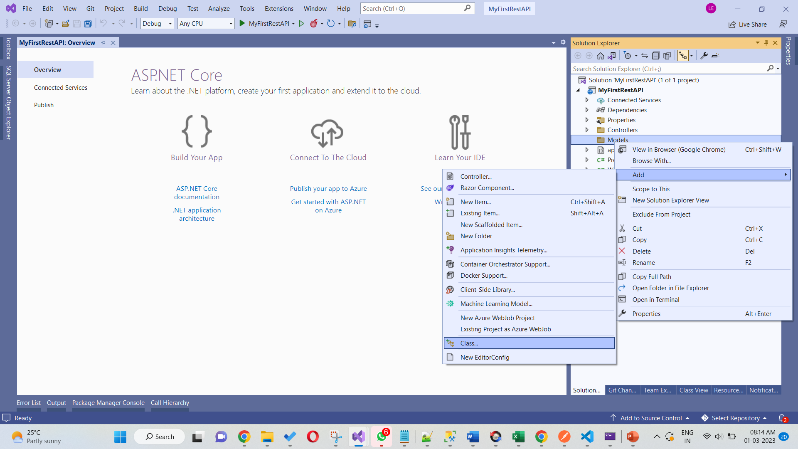
Right click model and add new class

Slide 14
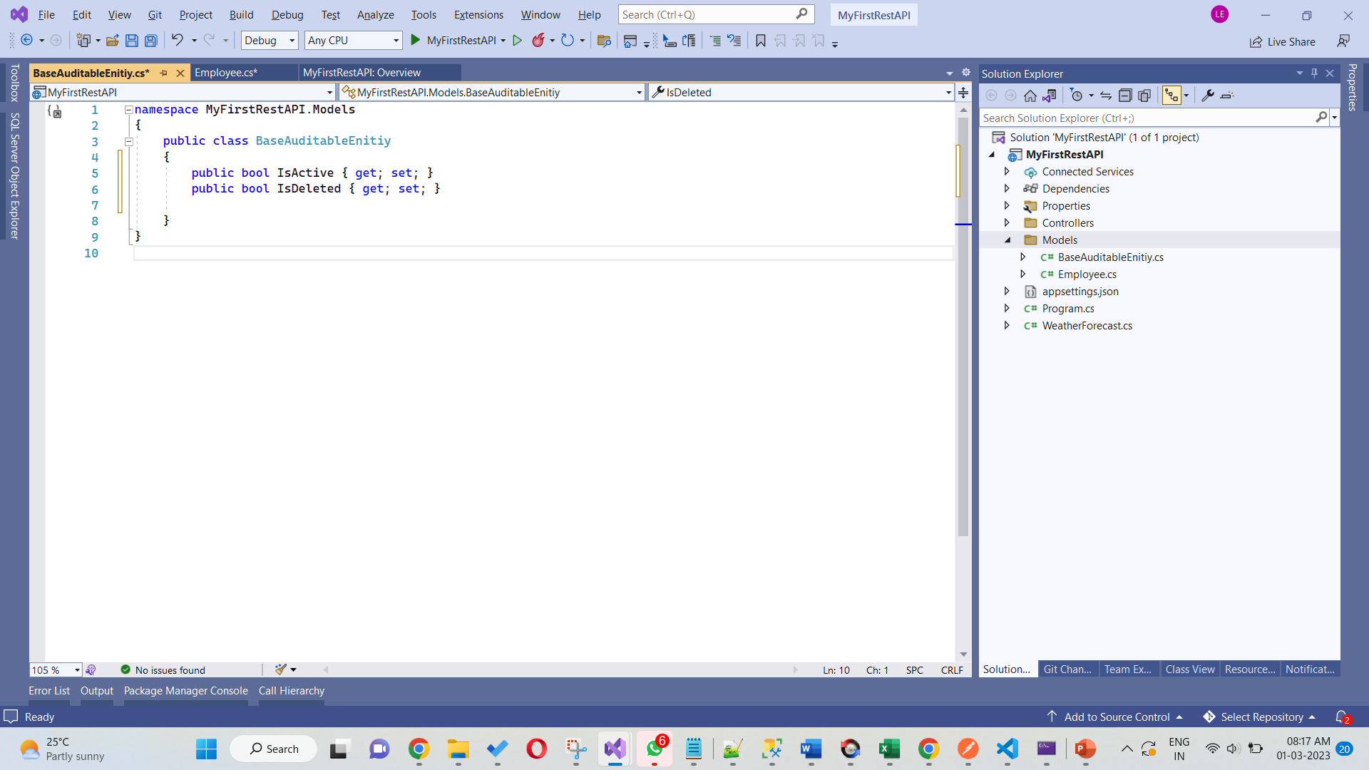
This is your base class. Need to inherit this class in your actual models. This class is common for all model.

Slide 15
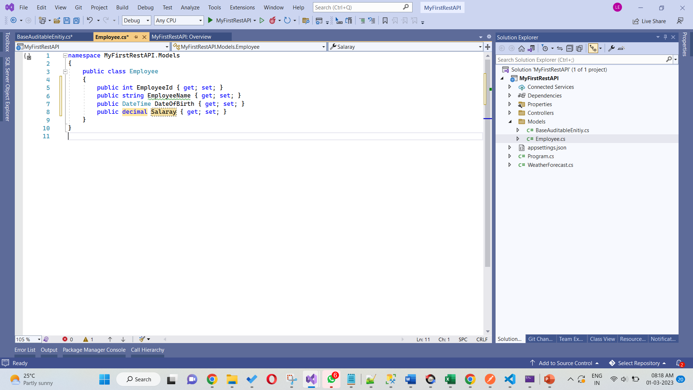
Employee class with some properties. Properties are going hold the values when we are passing values.

Slide 16
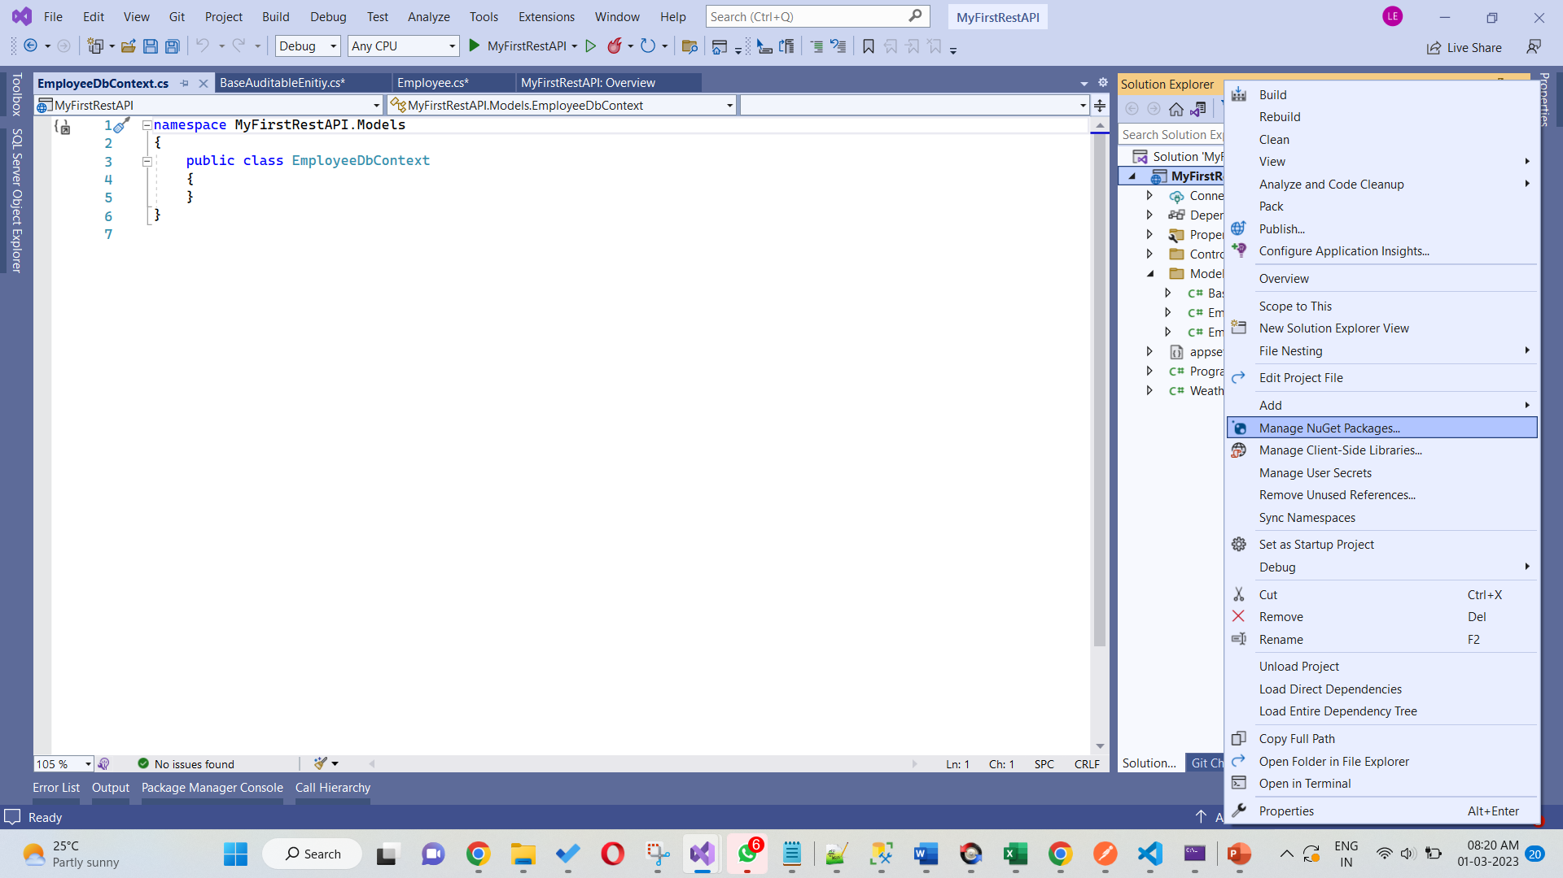
Now we are going to create dbcontext class which will be communicating to db which we are going to configure in the program.cs file
To enable this service need to install db service from nuget package manager. Right click the solution, go to “Manage nuket packages”

Slide 17
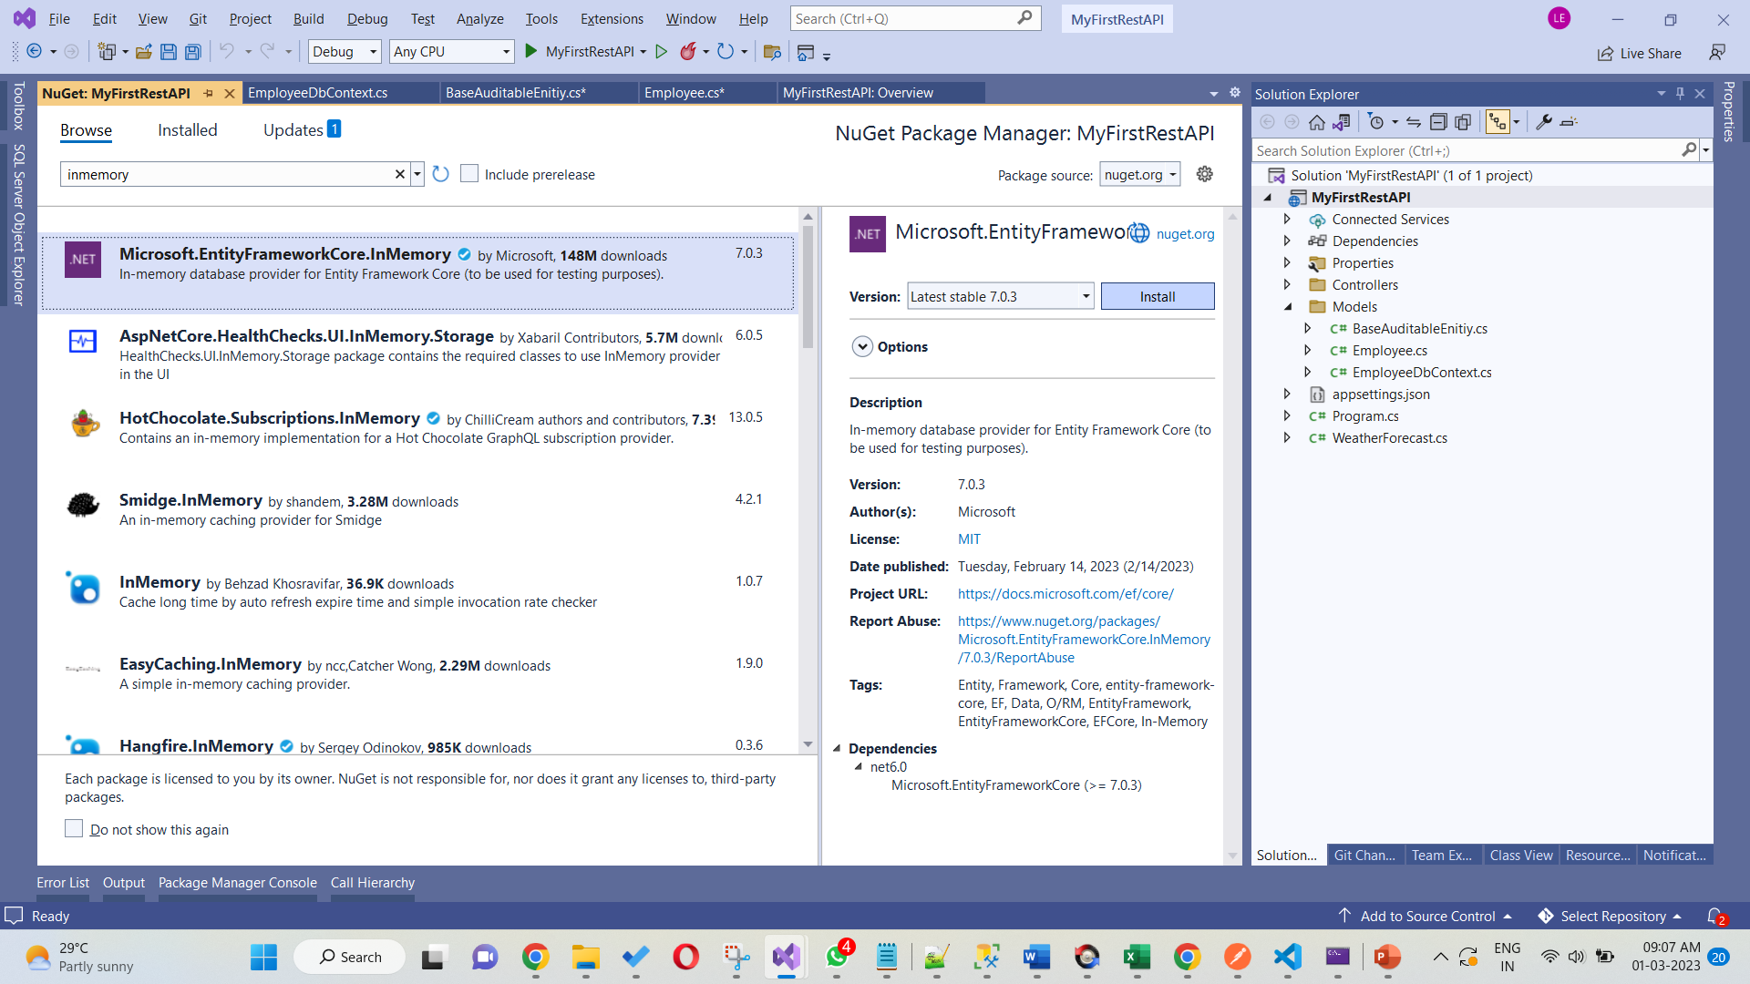
Install this package. It will be useful to interact with inmemory db.

Slide 18
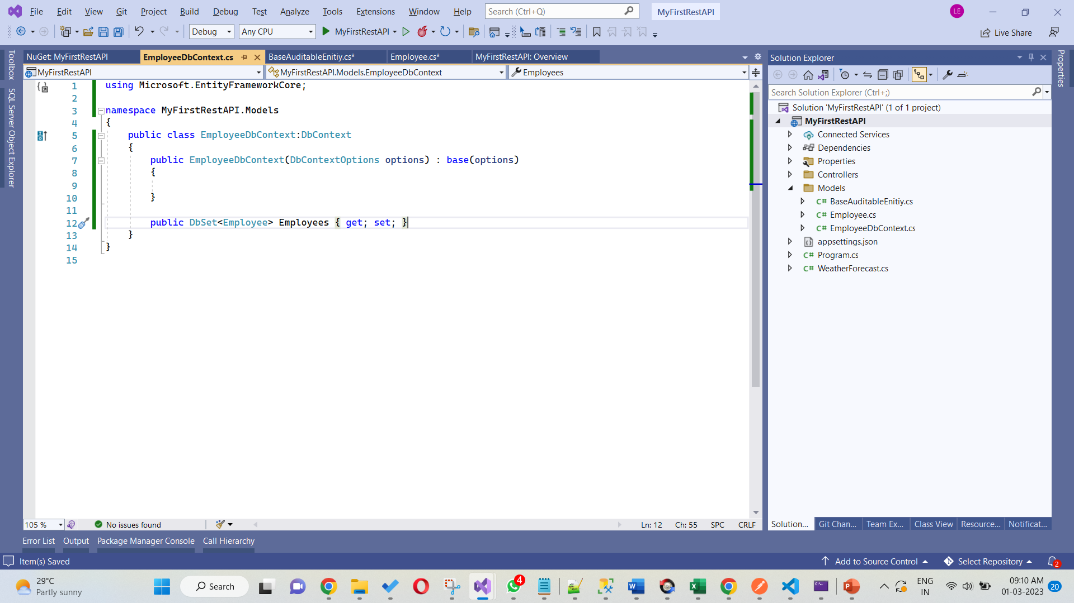
This is the configuration kind of file. Whatever models(tables) we are creating we need to map here. This will create table in inmemory database and process the data. Here I have added Employee model which we created now.

Slide 19
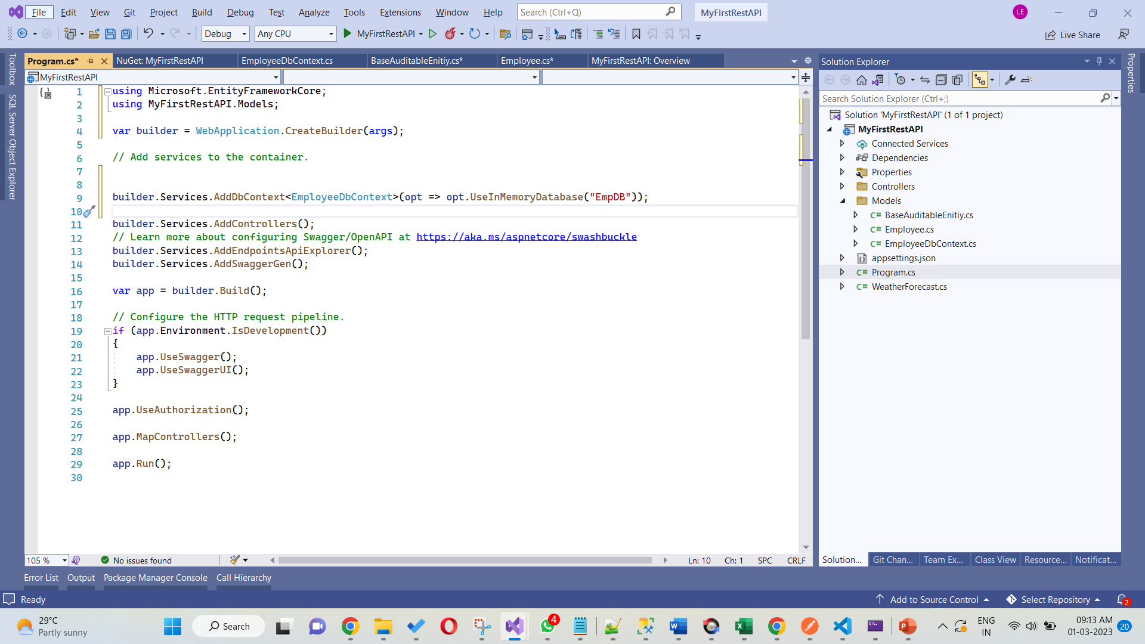
this program.cs file is kind of configuration file for the rest api. In this configuration we are going to add our database setting here. “EmpDb” is the dbname. You can mention any name you want. “EmployeeDbContext” reference is the input to the setting. It will give the table details which we configured in that file.

Slide 20
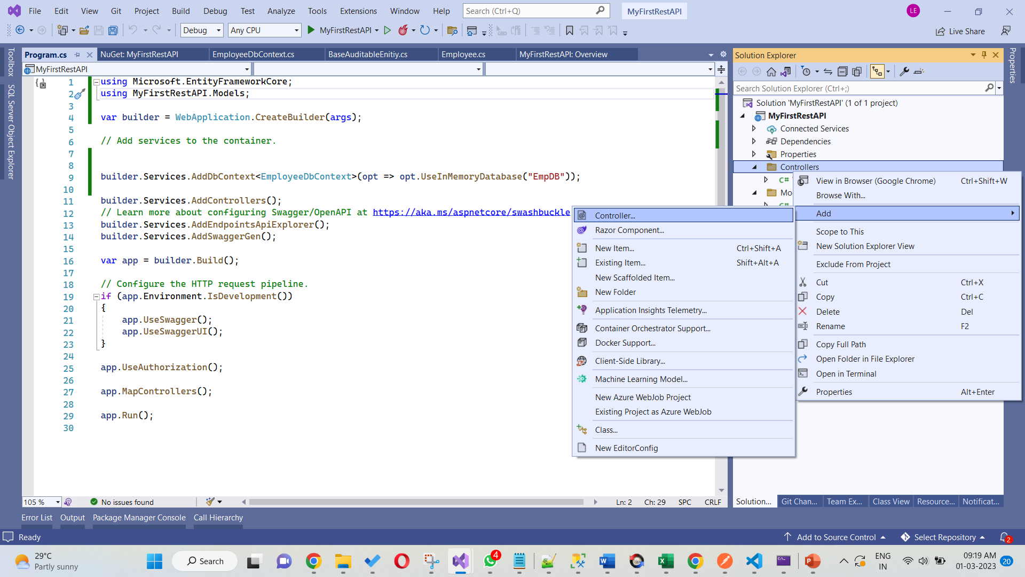
Now we have configured. Going to add endpoints(get,post, put methods)
For that, right controller then add new controller

Slide 21
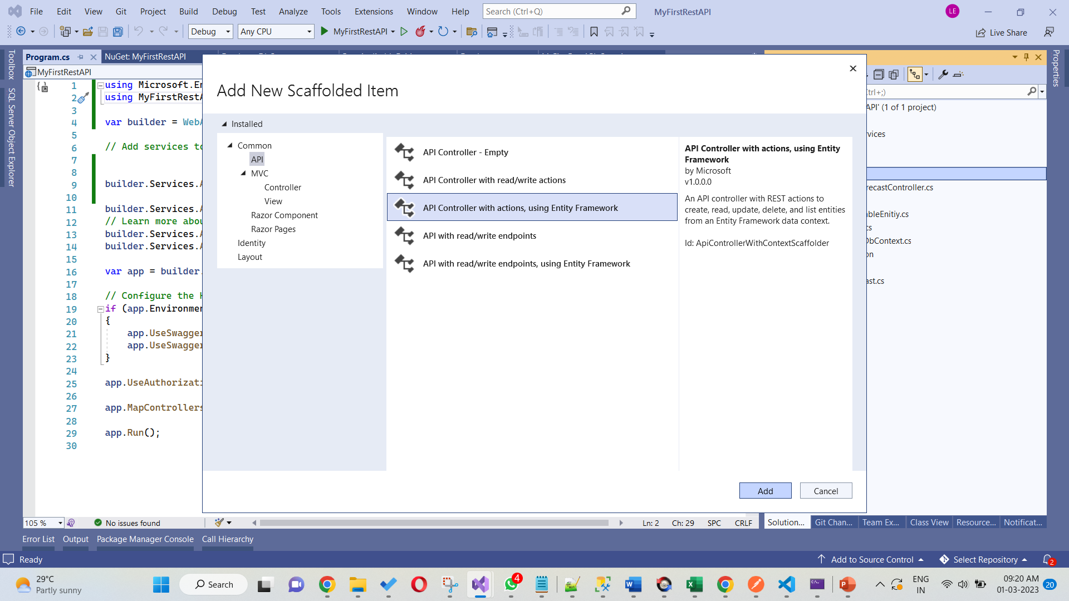
Instead creating endpoint class manually, we are going to create from the template. Like in the image you can select the options and click “add”

Slide 22
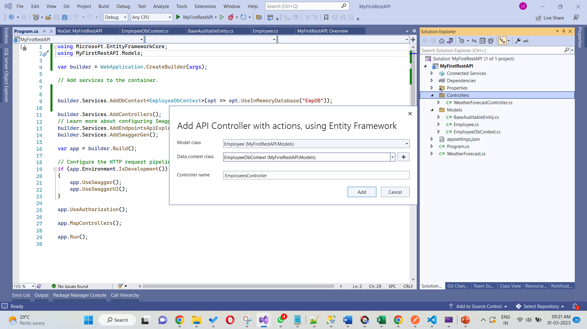
Model class: choose what you have created as table/model
Context class: choose which setting we are going to use as db service..
Controller: Give Name to controller. By default name will appear you can leave it as it is. If you want to change you can change but you can keep “Controller” as suffix..
Then click add

Slide 23
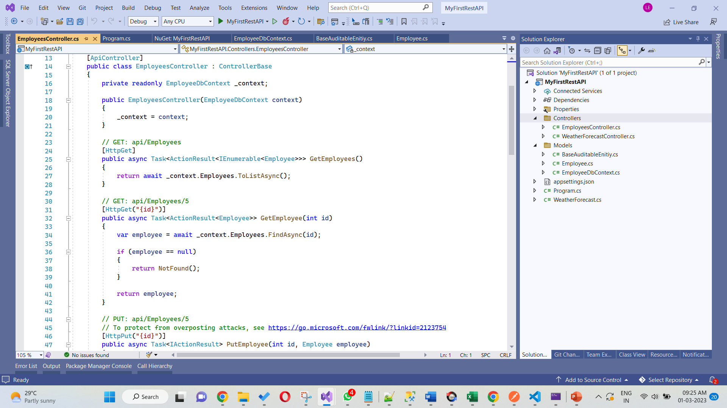
Now you can see the endpoints are created dynamically.

Slide 24
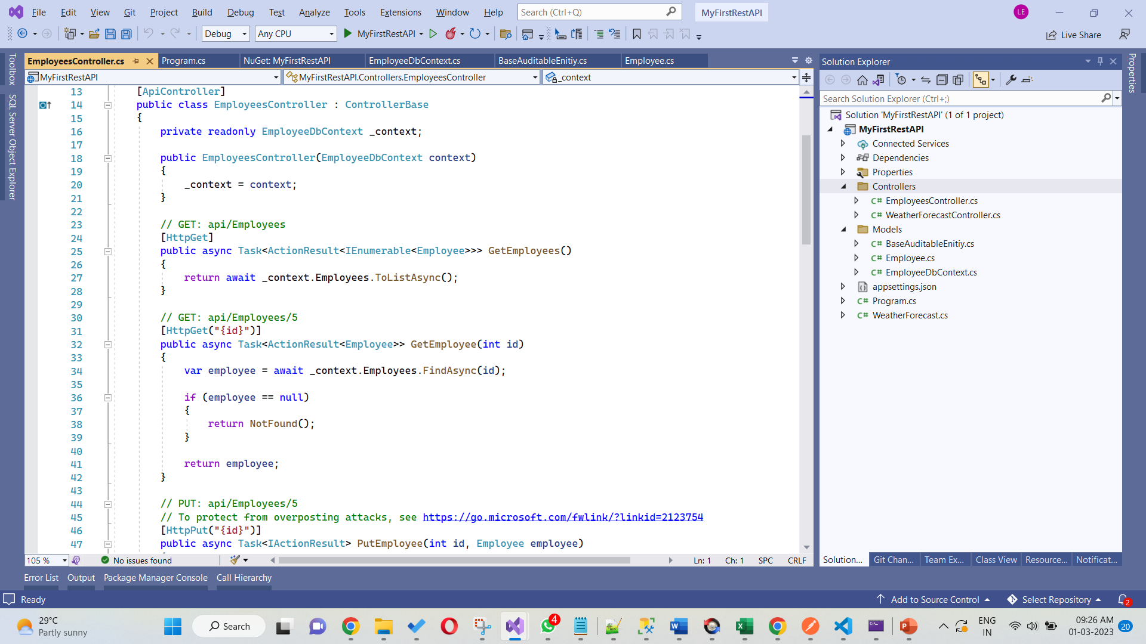
GetEmployees Method:
This will return all the employees from database
GetEmployee by Id: this will return specific employee based on id
Likewise you can understand other methods

Slide 25
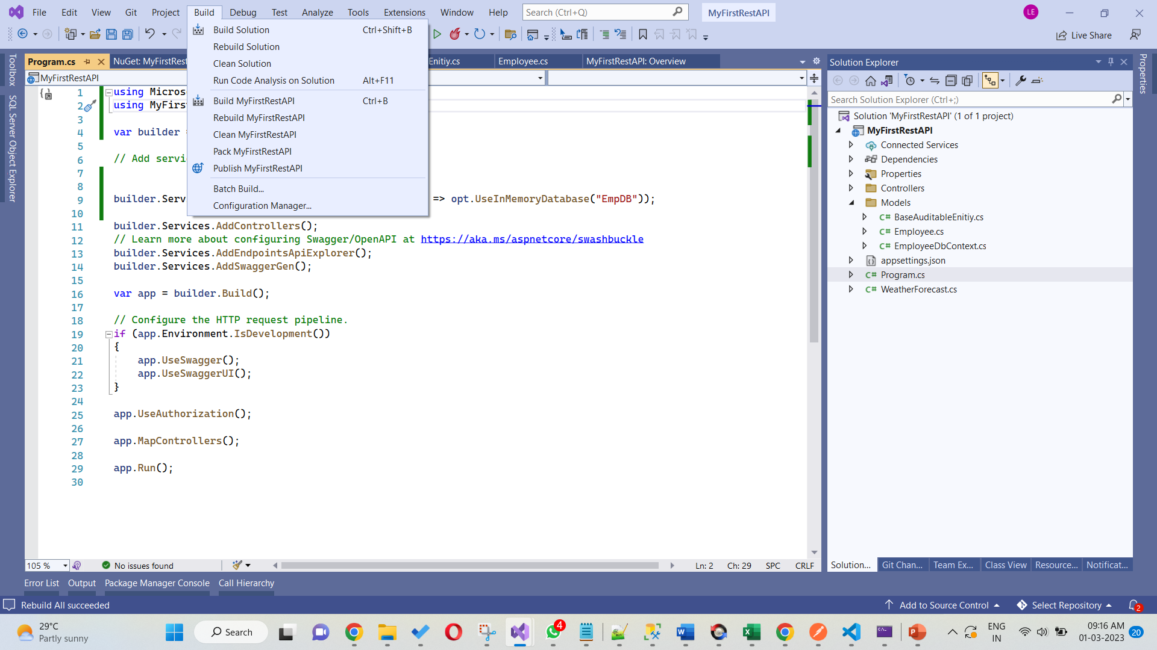
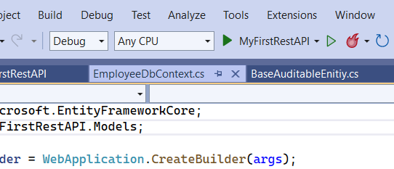
Build the solution to check whether we have any issues.
Then run the solution

Slide 26
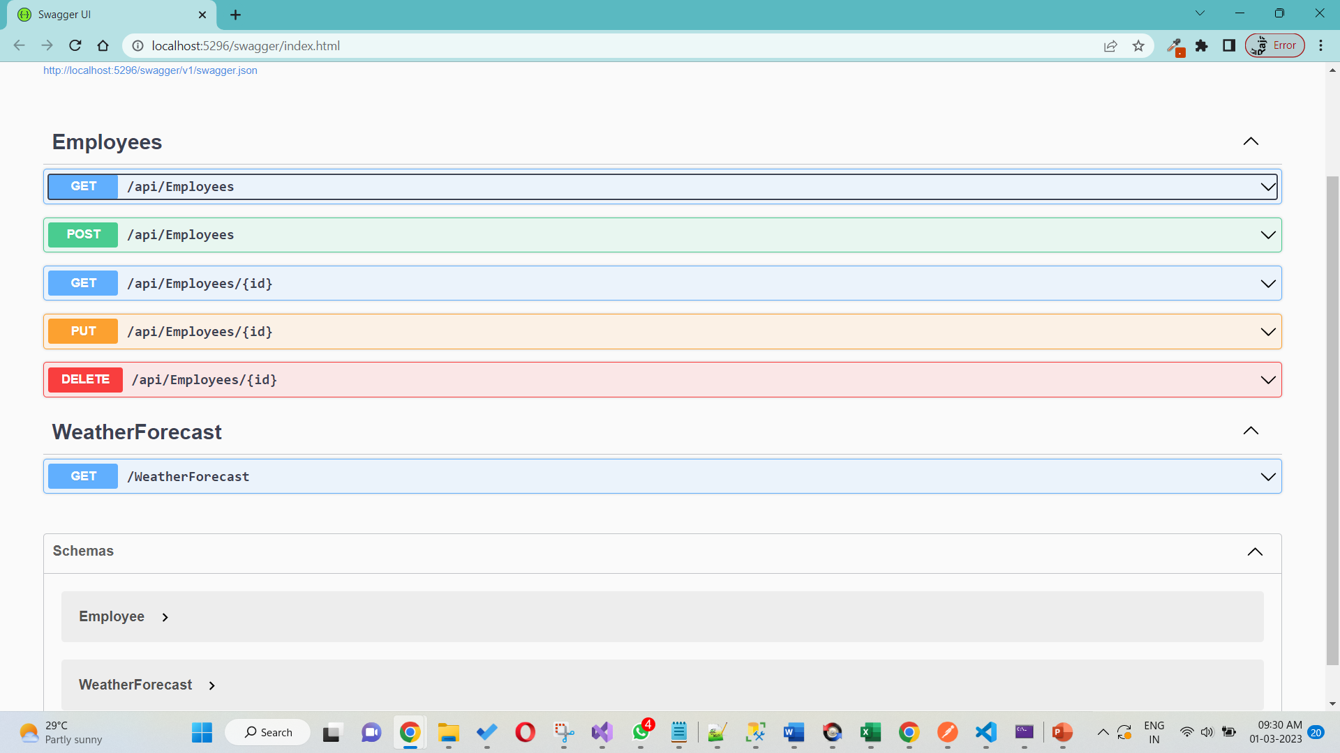
Once you run without error you will get this screen: now try add entries from post method..
Then run the first get method to return all the employees. Then add another employee. Like that you can explore other endpoints. Note: That data will be save temporary once you close the solution it will disappear in the next time run.

Slide 27
Life Cycle
Routing: When a client sends a request to an API endpoint, the ASP.NET Core routing middleware maps the requested URL to an appropriate action method in the API controller based on the configured routes.
Model binding: Once the appropriate action method is found, the ASP.NET Core model binding middleware reads the incoming request and maps the relevant data to the parameters of the action method.
Model validation: The ASP.NET Core validation middleware then validates the model and returns any validation errors to the client if the data is invalid.
Action execution: Once the model is bound and validated, the action method is executed, and the logic specific to the API endpoint is performed. This may involve accessing a database, performing calculations, or calling external services.
Result execution: After the action method has completed, it returns an ActionResult object, which contains the data to be returned to the client. The ASP.NET Core result execution middleware then processes the result and creates an appropriate HTTP response based on the data.

Slide 28
Life Cycle
6. Response caching: If caching is enabled, the ASP.NET Core response caching middleware may store the HTTP response in a cache to optimize future requests for the same data.
7. Response compression: If compression is enabled, the ASP.NET Core response compression middleware may compress the HTTP response to reduce its size and improve performance.
8. Response formatting: Finally, the ASP.NET Core content negotiation middleware selects the appropriate content formatter based on the requested data format, such as JSON or XML, and formats the response accordingly.

Slide 29
Advance concepts
Basic | Packages/Medium | Advance
Data Types | Auto mapper | Solid principles
Class, Object | Dependency Injections | Autofac
Inheritance | Data Annotations | fluentapi
Interface | Dto | Gridify
Method Overloading, Overriding | Linq | Clean Architecture
Git Repository | Sql joins, basics | Repository Pattern
 | Generic class | Generic Repository Pattern

Slide 30
THANKS!
Do you have any questions?
logaraja@wisright.com, +91 96000 54045 wisright.com
https://www.linkedin.com/in/007worldking/

